Slide 1
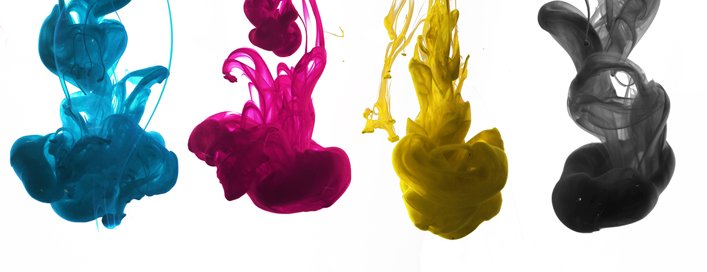
VCE PrintArray Solution
High Quality, High Volume, Low Cost Workgroup Color Printing
September 19th 2024
Notes:
Program has been in place for 5 years
Provided full time employment for over 120 offenders while in custody many now successful returning citizens - Barksdale
Saved COV over $2M in expense cost reduction
Generated over $7M in revenue and over $2M in income for VCE
New technologies have emerged in the last 2/3 years creating opportunities for enhanced offender training and employment opportunities

Slide 2

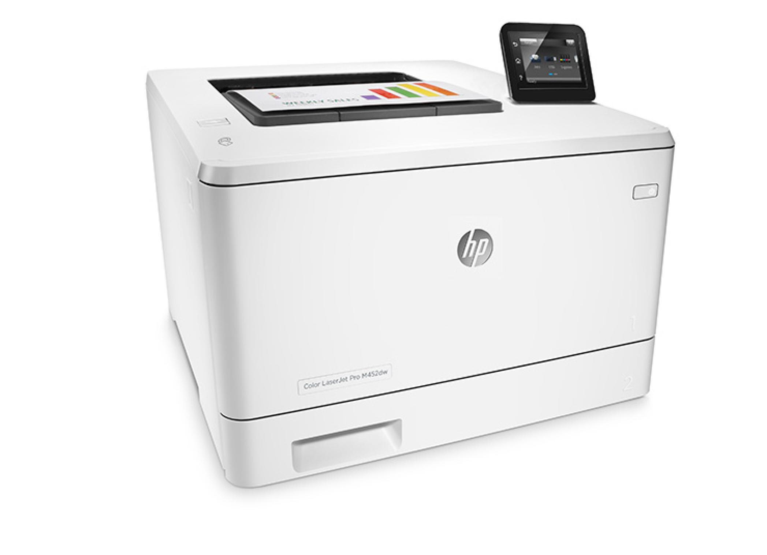
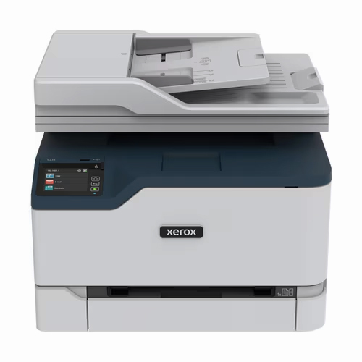
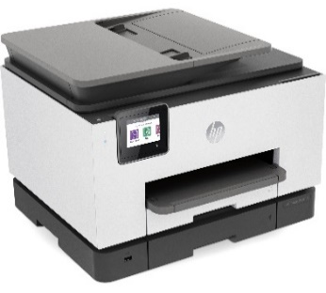
Market Landscape
The Small Office Workgroup (up to 10 users) Color Print market is currently dominated by laser printers, such as the HP M454DN or the Xerox C325, and thermal inkjet printers such as the HP OfficeJet Pro 9720.
HP M454DN
Xerox C325
HP OfficeJet Pro 9020
Technology Introduction Date | 1985
Printer Cost | $649.99
Power Consumption | 550w
Print Speed | up to 28ppm
Print Quality | up to 600 dpi
Cost per page | 16 cents/page
Cost for Consumables (6,000 Page Yield) | $1,014.96
Total Solution Cost | $1,664.95
Technology Introduction Date | 1986
Printer Cost | $499.99
Power Consumption | 650w
Print Speed | up to 30ppm
Print Quality | up to 1200 dpi
Cost per page | 14 cents/page
Cost for Consumables (6,000 Page Yield) | $877.96
Total Solution Cost | $1,377.35
Technology Introduction Date | 1986
Printer Cost | $229.99
Power Consumption | 75w
Print Speed | Up to 22ppm
Print Quality | Up to 1200 dpi
Cost per page | 11 cents/page
Cost for Consumables (6,000 Page Yield) | $626.93
Total Solution Cost | $856.92
Notes:
This is an example of a popular desktop HP color laser printer in use across DOC and COV
Essentially 1980’s technology which uses extremely high temperatures to fuse toner to the paper
Expensive and wasteful

Slide 3
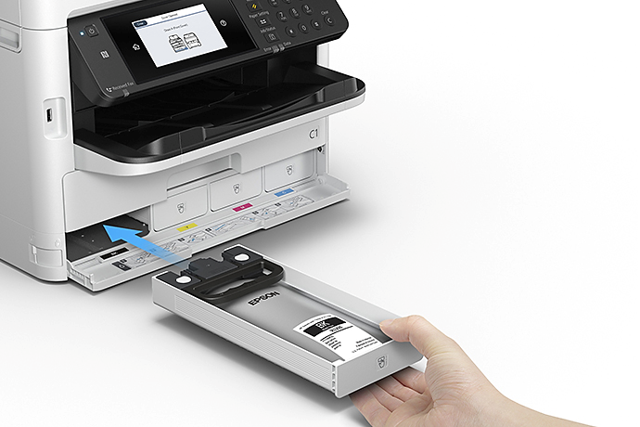
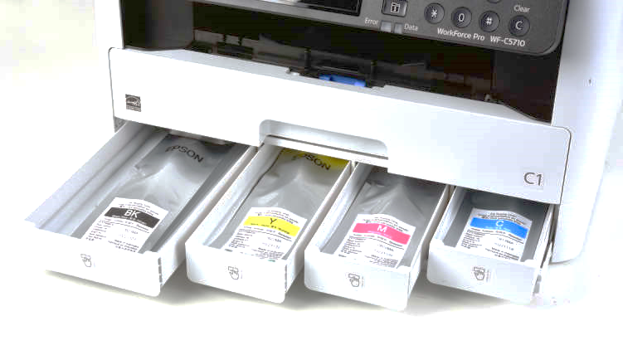
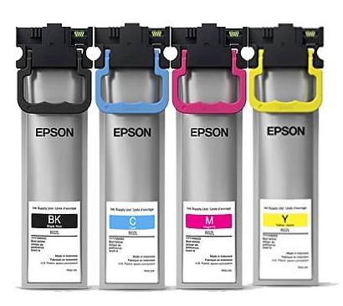
Piezo Ink Technology
Epson has developed its Precision Core Piezo Ink Technology (2018) to deliver equivalent quality and page speed performance to color laser printers but at a significantly lower cost.
These are available in the Epson WF-C5890 Workgroup Printer
Compared to equivalent color laser printers, these machines offer:
Acquisition Cost (per VITA contact) | $350
Power Consumption | 27W
Print Speed | up to 25ppm
Print Quality | up to 4800 x 1200 optimized dpi
Notes:
2015 disruptive technology

Slide 4
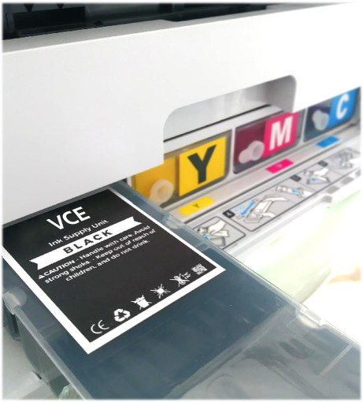
The VCE PrintArray Solution
VCE PrintArray Workgroup Color Printer
Base Print Engine | WF-C5890
Firmware | Custom firmware
Supplies | VCE renewable ink cassettes
Cassette Capacity | 30,000 pages
Cost per page (same for monochrome and color) | 2 cents/page

Slide 5
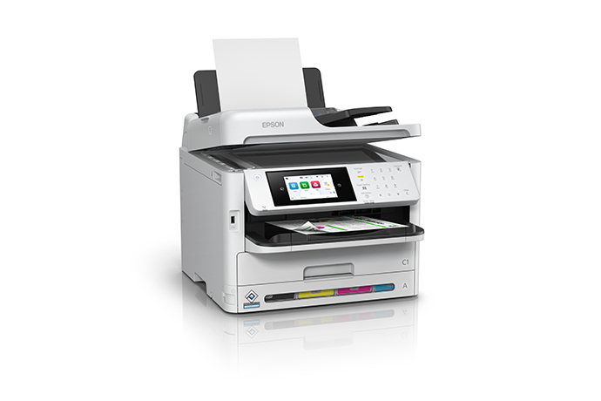

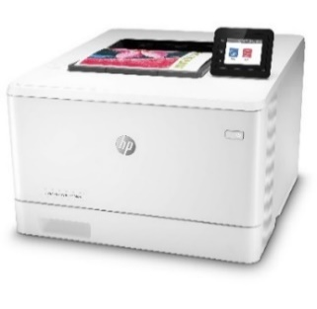

Cost Comparison Charts

Slide 6
VCE PrintArray – Multiple User Model

Slide 7
VCE PrintArray – Multiple User Model Charts

Slide 8
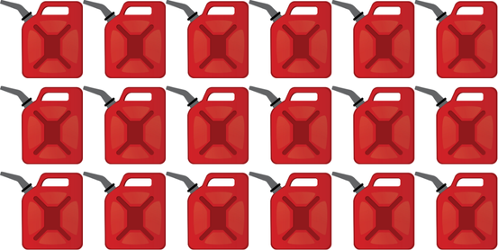

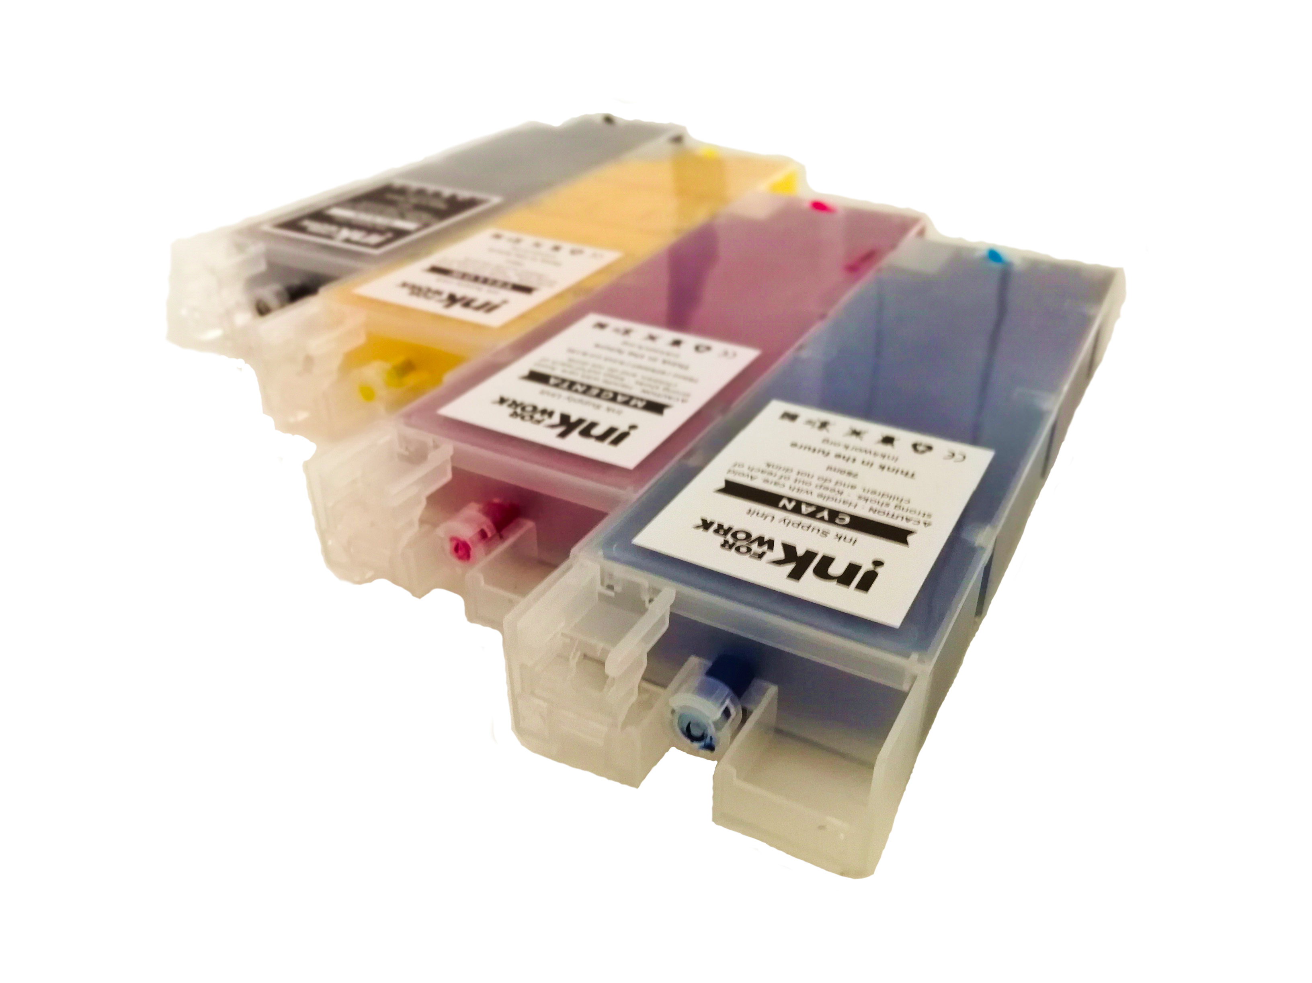
Zero Waste
It takes over 3 quarts of oil to produce each toner cartridge – that’s 18 gallons just to print 30,000 pages.
Nineteen toner cartridges yield 30,000 pages for $4,875.81
VS
In addition to the packaging waste, that’s over 38 pounds of plastic and metal waste that will go to landfill.
Four PrintArray Cassettes
yield 30,000 pages for $739.88 and with Zero Waste

Slide 9
Extract from Daly VITA Contract

Slide 10
MPS Comparison
Notes:
This is an example of a popular desktop HP color laser printer in use across DOC and COV
Essentially 1980’s technology which uses extremely high temperatures to fuse toner to the paper
Expensive and wasteful

Slide 11
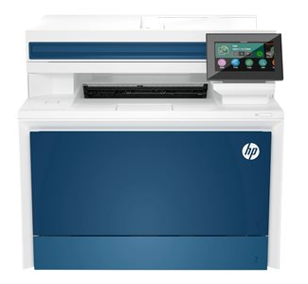
MPS Comparison Chart

